Slide 1

Welcome to
Our Sunday School
We’ll start at 9:07
visit OurSundaySchool.com for more about our class

Slide 2
Philemon, week 9 (pages 17-24)

Slide 3
Philemon 1:15–16
For perhaps this is why he was separated from you for a brief time, so that you might get him back permanently, no longer as a slave, but more than a slave—as a dearly loved brother. He is especially so to me, but how much more to you, both in the flesh and in the Lord.

Slide 4
Philemon, week 9 (pages 17-24)

Slide 5
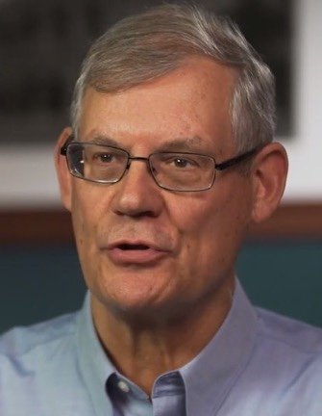
Dr. Douglas J. Moo
The sentence we are dealing with is about what Paul suspects might be God’s purpose in the circumstances of Onesimus’s situation

Slide 6
Philemon, week 9 (pages 17-24)

Slide 7

BDAG on tacha
TACHK-uh
marker expressing contingency ranging between probability and bare possibility
perhaps, possibly, probably

Slide 8
Philemon, week 9 (pages 17-24)

Slide 9
Caveat emptor

Slide 10
Caveat emptor caveat lector

Slide 11
Romans 8:28
We know that all things work together for the good of those who love God, who are called according to his purpose.

Slide 12
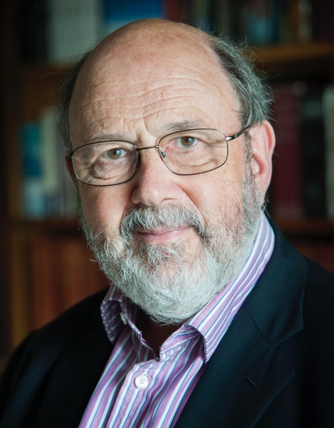
Dr. N. T. Wright
In… attempting to understand a situation, from God's point of view… there is always room for restrained speculation about the providential purpose that may underlie curious events.

Slide 13
Dr. N. T. Wright
If [Romans 8:28] is true, it is also true that Christians are sometimes and to a limited extent, privileged to catch a glimpse of how this is being accomplished.

Slide 14
Dr. N. T. Wright
The perhaps… is the necessary qualification for all such claims: they remain a matter of faith, not sight.

Slide 15
Dr. N. T. Wright
Joseph, like Paul, held a steady belief in God’s providential overruling of human sin and folly.
Patience and forgiveness grow well in soil like that.

Slide 16
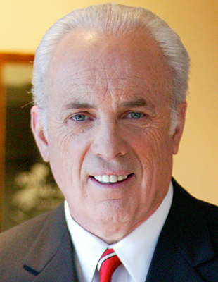
Dr. John MacArthur
God triumphs over sin through His providential power and grace. He takes the myriad contingencies of human actions and uses them to accomplish His own purposes.

Slide 17
Philemon, week 9 (pages 17-24)

Slide 18
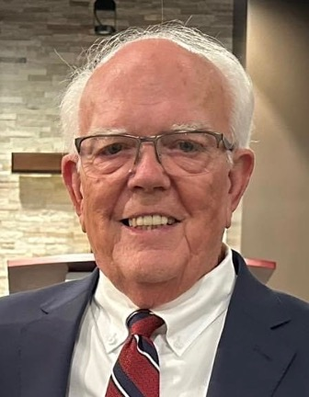
Dr. Richard Melick
Paul assumed what he taught in Col 3:22–4:1. According to Paul’s instructions, slaves and masters can coexist as Christians even in undesirable economic arrangements.

Slide 19
Philemon, week 9 (pages 17-24)

Slide 20
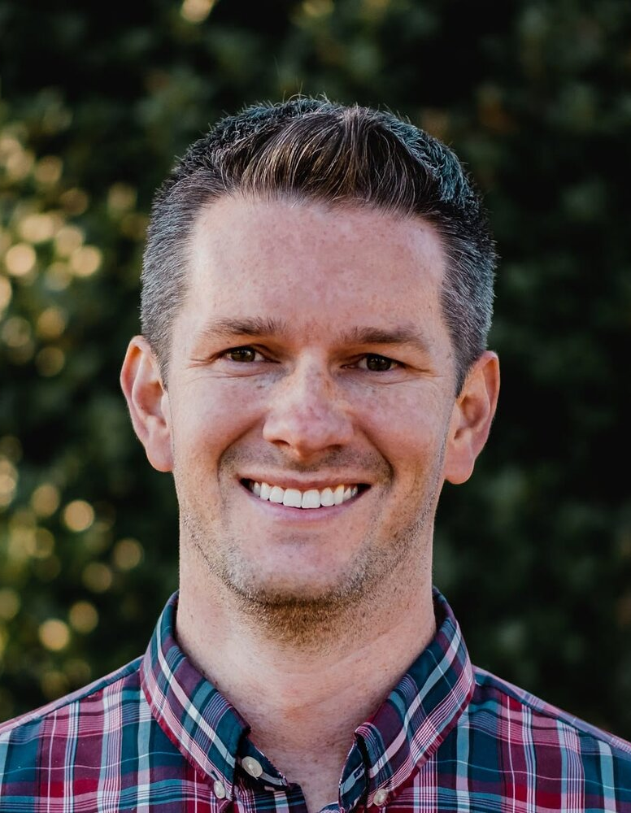
Matt Smethurst
Church is where
‘it’s not my business’
goes to die.

Slide 21
Philemon, week 9 (pages 17-24)

Slide 22
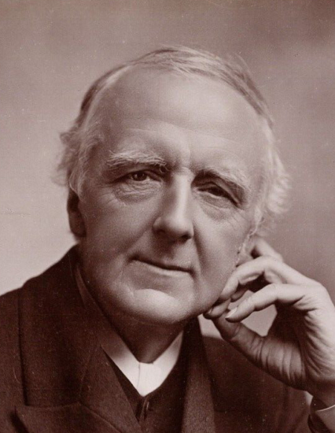
F. B. Meyer
In the flesh Philemon had the brother for a slave; in the Lord he had the slave for a brother

Slide 23
Philemon, week 9 (pages 17-24)

Slide 24
Dr. Douglas J. Moo
However difficult the situation, and however much Onesimus might have been at fault, God had a beneficial intention in view

Slide 25
Prayer time
Write down your prayer requests (on the Weekly Update or in the comments)
Lean in, engage, and pray for someone not with you
Be out of this room by 9:50
Go worship

